Slide 1

React Fundamentals
Node Introduction

Slide 2
Topics
Day 1 Review
JSX
Node.js
NPM
Create React App

Slide 3
Node Introduction
Day 1 Review Discussion

Slide 4
Think, Discuss, and Share
What is a callback function?

Slide 5
Think, Discuss, and Share
What are some of the benefits of React?
Notes:
Flexible
Fast
Reusable
Strong community support
Easy to learn

Slide 6
React Introduction
Getting Started with React

Slide 7

Getting Started with React
Typically, developers will initialize new projects using a generator such Create React App
A minimum version of React can be added to an HTML page via CDN

Slide 8

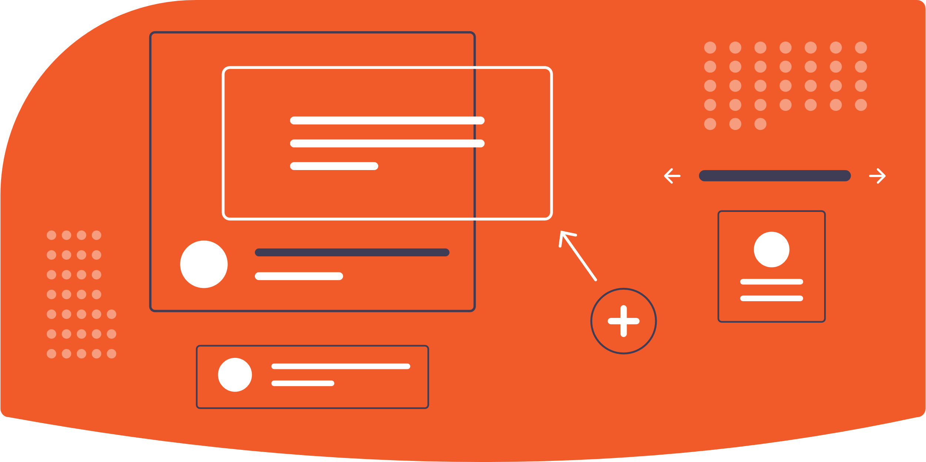
What’s a Component?
Encapsulated piece of code
Responsible for rendering a specific portion of the page
Can contain other ‘child’ components rendered inside

Slide 9

JSX (JavaScript Syntax Extension)
An HTML-like syntax for creating components
Allows the use of embedded JS expressions
Not included in base React library
Not required, but recommended!

Slide 10
Node Introduction
What is Node.js?

Slide 11

What is Node.js?
Node.js is a JavaScript runtime that executes JavaScript code outside the browser
Is open source, and runs on most platforms (Windows, Linux, Unix, Mac OS)
Can be used to develop entire full stack web applications using only JavaScript
Check currently installed version with `node –v` command

Slide 12
Node Introduction
What is NPM?

Slide 13

What is NPM?
NPM (Node Package Manager) is the default package manager for Node.js, included with installation
Is a command line tool that can be used to install packages from the npm registry
Check currently installed version with `npm –v` command
Notes:
https://www.npmjs.com/

Slide 14
Node Introduction
Create React App

Slide 15

What is Create React App
Create React App is a command line tool for quickly generating new React applications pre-configured tools such as webpack and Babel
Includes a development server useful for seeing local changes update to apps reflected in real time
Notes:
https://www.npmjs.com/

Slide 16




Let’s try it!

